Slide 1

Welcome to our lesson
Class 7

Slide 2





Who's a milionaire?
Where is Hoa from?
50:50
A. I am from Hue
B. She is from Hue
B. She is from Hue
C. She is from Ha Noi
D. She from Hue

Slide 3
Who's a milionaire?
Where do Hoa’s parents live ?
50:50
A. They live on Hue
B. They live in Ha Noi
C. They live in Hue
D. They lives in Hue
C. They live in Hue

Slide 4
Who's a milionaire?
Which class is Hoa in?
50:50
A. She is in class 7A
A. She is in class 7A
B. I am in class 7A
C. She is in class 6A
D. I am in class 6A

Slide 5
Who's a milionaire?
Hoa is staying with …………..
50:50
A. her friends
B. her uncle and aunt
B. her uncle and aunt
C. her parents
D. her uncle.

Slide 6

Wednesday, September 15th, 2021
Unit 1 (cont)
B - Names and addresses

Slide 7
Pham Thi Hoa 12 Tran Hung Dao Street
Family name
middle name
first name
address
full name

Slide 8
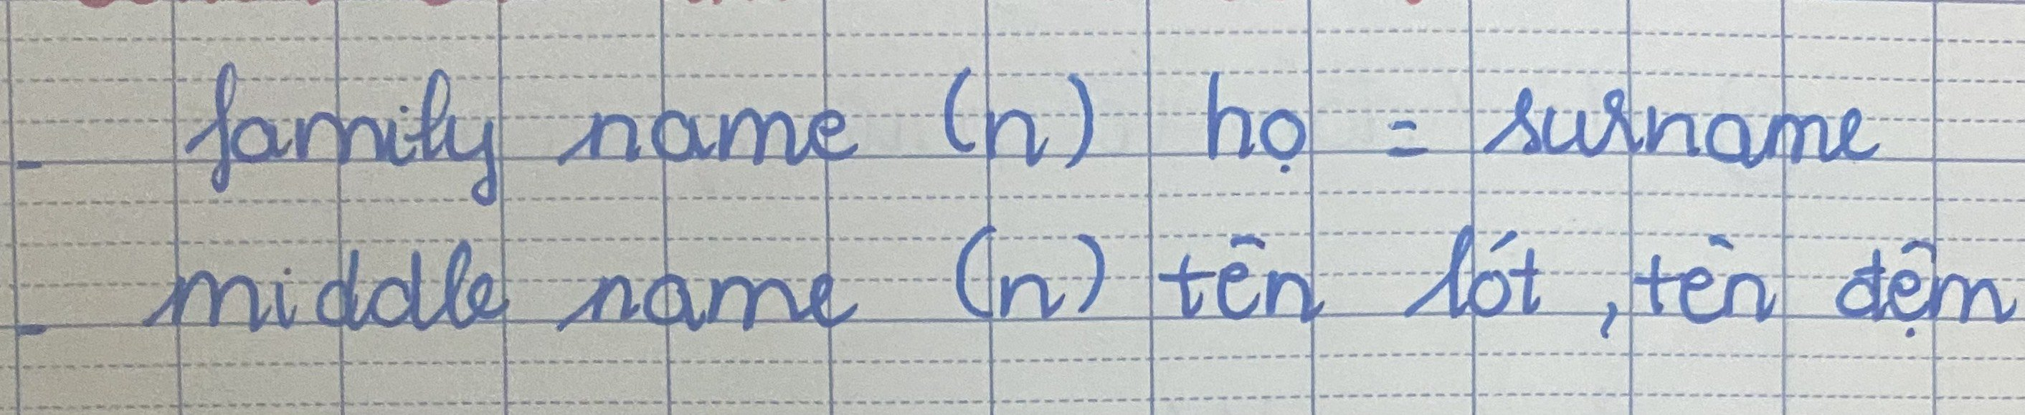
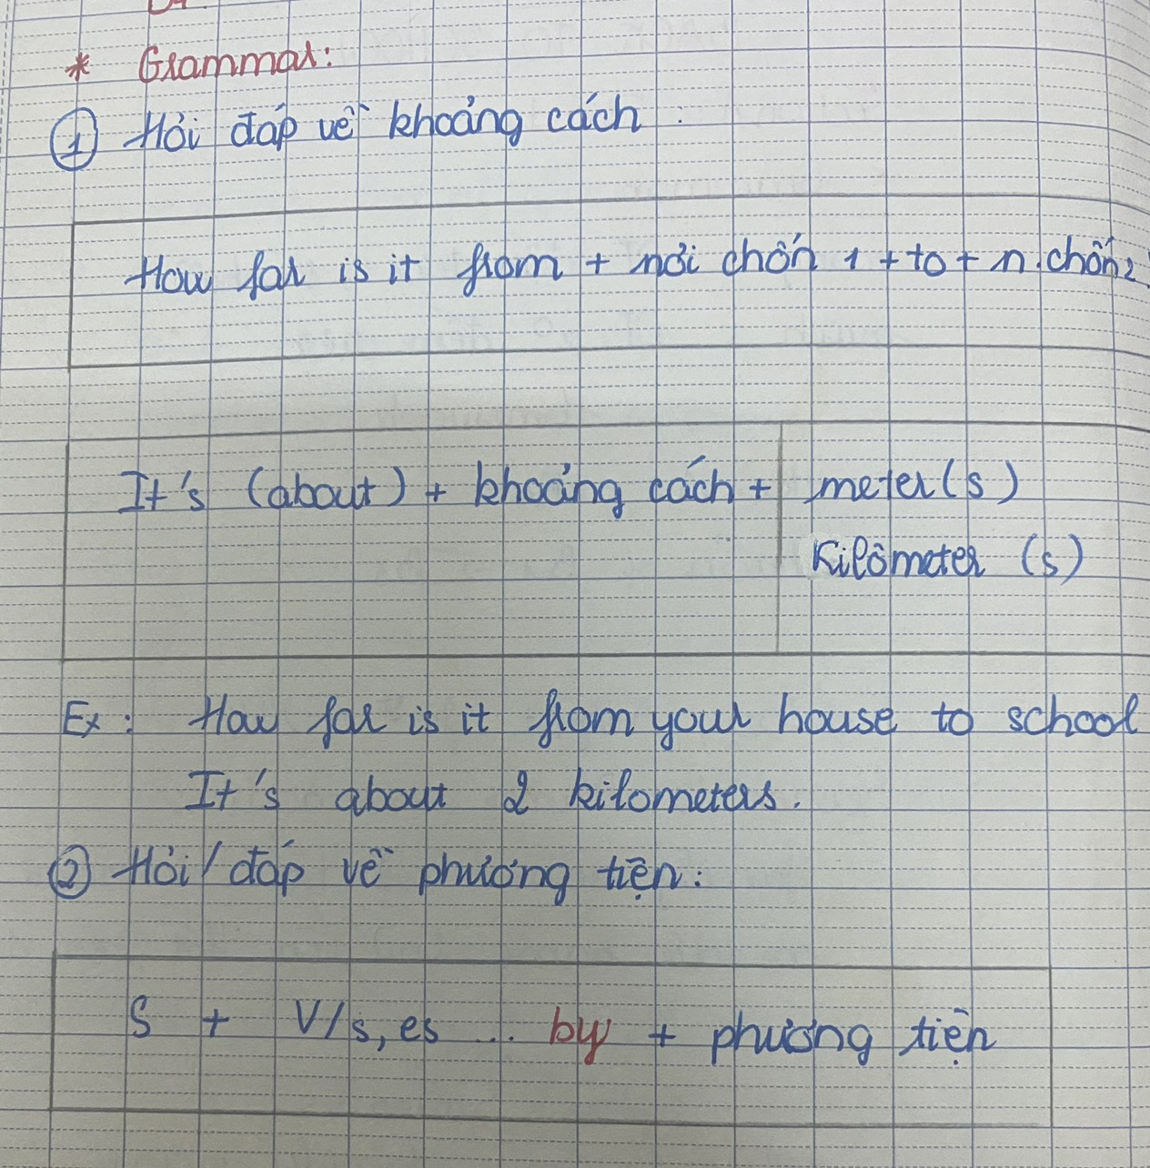

Slide 9
I. Grammar
WH- question words
- Cấu trúc thông dụng của các từ để hỏi trong tiếng Anh
Từ để hỏi + trợ động từ + chủ ngữ
+ động từ chính + phần còn lại
Ex: What do you want to do?
Từ để hỏi+ be+ Chủ ngữ+ phần còn lại?
Ex: Where is John?
* Các từ để hỏi trong tiếng Anh
- Who: Dùng để hỏi về người
Ex: Who’s your boyfriend?
- What: Dùng để hỏi thông tin về một thứ gì đó
Ex: What are you doing?
- When: Dùng để hỏi về thời gian
Ex: When will you comeback home?
- Where: Dùng để hỏi về địa điểm, vị trí
Ex: Where do you live?

Slide 10
- Which: Dùng để hỏi về sự lựa chọn
Ex: Which pen do you like?
- Why: Dùng để hỏi về lý do, nguyên nhân
Ex: Why do you buy this skirt?
- Why don’t: Dùng để đưa ra lời gợi ý
Ex: Why don’t you go out tonight with us?
- How: Dùng để hỏi về cách thức, đặc tính cũng như tính cách của chủ thể.
Ex: How are you?
- How long: Dùng để hỏi về thời gian
Ex: How long will you finish the task?
- How much/how many: Dùng để hỏi về số lượng: không đếm được (much),
đếm được (many):
Ex: How many people are there in your class?
How much sugar do you need to drink?
- How far: Dùng để hỏi về khoảng cách.
How far is it from ...............to............?
It’s about ………….. kilometer (s)
meter (s)
Ex: How far is it from your house to school ?
→ It’s about 2 kilometers.
400 meters.

Slide 11


Unit 1: BACK TO SCHOOL
B ₋Names and addresses
1. Listen. Then practice with a partner:
What
Miss Lien : What’s your family name, Hoa?
Hoa : It’s Pham. My middle name is Thi.
Miss Lien : How old are you?
Hoa : I’m 13.
Miss Lien : Where do you live?
Hoa : 12 Tran Hung Dao street.
Miss Lien : Thank you, Hoa.
family name
middle name
How
Where

Slide 12

* Answer:
a. Who is Hoa talking to?
* Hoa talking to Miss Lien.
b. What is Hoa’s family name?
* It’s Pham.
c. What is her middle name?
* Her middle name is Thi.
d. Where does she live?
* She lives at 12 Tran Hung Dao street.

Slide 13
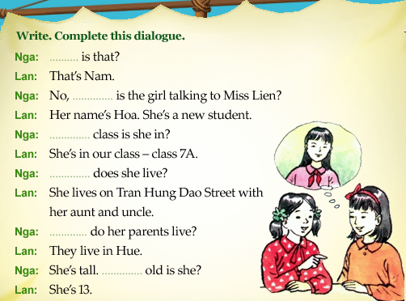

Slide 14
Who
who
Which
Where
Where
How

Slide 15

Full name: Pham Thi Lan
Age : 16
Address : Ha Noi
1. What’s her first name?
Her first name is Lan.
2. What’s her family name?
Her family name is Pham.
3. How old is she?
She is sixteen years old.
4. Where does she live?
She lives in Ha Noi.

Slide 16
Group 1
Group 2
Full name: Nguyen Van Nam
Age : 14
Address : 28 Yen Hoa street
Full name: Tran Thi Lan
Age : 13
Address :7 Yen Ninh Street
Group 3
Group 4
Full name: Le Bao Ngoc
Age : 17
Address :5 Yen Thinh Street
Full name: Vo Quang Huy
Age : 15
Address :8 Tran Phu street

Slide 17

Name | Age | Class | Address
Lan
13
7A
12 THĐ street
Which class are you in ?
I live at 12 THĐ street
Where do you live ?
I am in class 7A
My name is Lan
What’s your name?
I am 13 years old
How old are you ?

Slide 18
4. Practice the dialogue :
Nam : Where do you live, Hoa?
Hoa : I live at 12 Tran Hung Dao street.
Nam : How far is it from your house to school?
Hoa : It’s not far, about one kilometer.
Nam : How do you go to school?
Hoa : I go to school by bike.

Slide 19
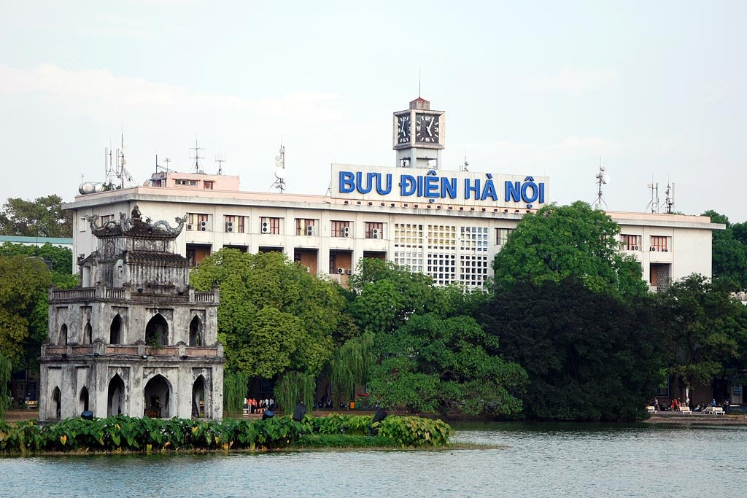
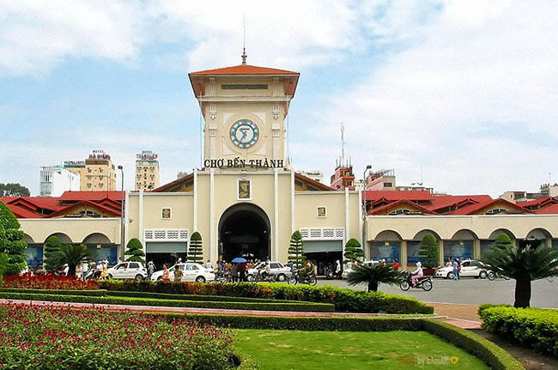
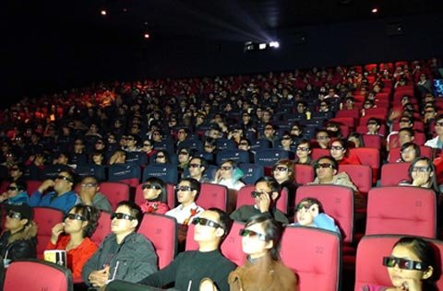

5. Ask and answer with a partner:
How far is it from the ............... to the ............ ?
→ It’s about ………….. kilometer (s) / meter (s)
Post office
1 kilometer
Market
200
m
3
km
Movie theater
Bus stop
500 meters

Slide 20
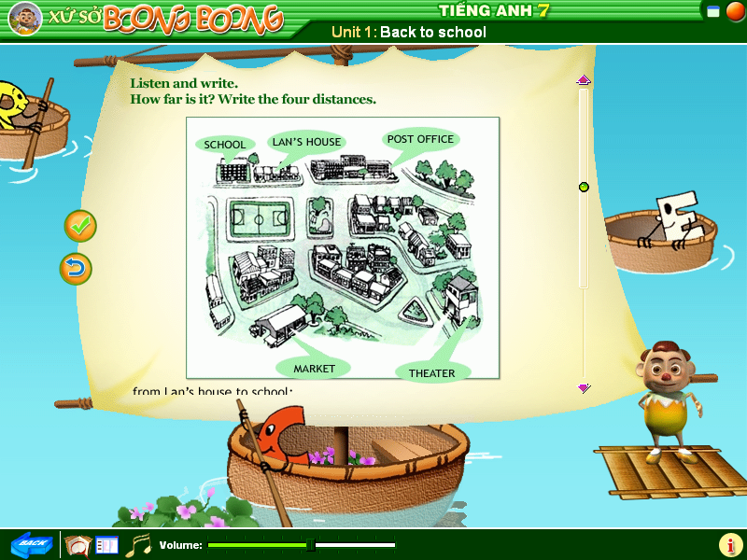

a. Is Lan’s house near from school / market?
b. Is Lan’s house far from the movie theater?

Slide 21
4. Listen four dialogues and find the distance of places
1. From school to Lan’s house.
a.200m b.300m c. 600m
2. Lan’s house to the post office.
a. 400m b.500m c.700m
3. Lan’s school to the movie theater.
a.2km b.3km c.4km
4. Movie theater to the post office.
a.2km b.5km c. 6km

Slide 22
5. Listen and write
From |  | To | Distance
1. School |  | Lan’s house
2.Lan’s house |  | The post office
3.School | The movie theater
4. Theater | The post office
300 meters
700 meters
3 kilometers
2 kilometers
* Ask and answer about the four distances .
S1: How far is it from school to Lan’s house?
S2:It is...............

Slide 23
6. A survey
- What is your name ?
- Where do you live ?
- How far it is from your house to school ?
- How do you go to school ?
*Fill in the survey form
Name:.............................................................
Address:........................................................
Distance:.......................................................
Mean of transport:.......................................
Tran Thanh Long
50 Hamlet 3 – Gia Hiep
3 kilometers
motorbike

Slide 24
Exercise: I. Using Wh-question words to fill the blank
What
1 . …………………… is your family name ?
→ It’s Nguyen
2. . …………………… are you ?
→ I’m thirteen.
3. . …………………… does Minh live ?
→24 Ngo Quyen Street.
4. . …………………… do you live with ?
→ My parents.
5. . …………………… do you go to school ?
→ By bus
6. . …………………… do you have English ?
→ On Tuesday and Wednesday .
7. . …………………… are you unhappy ?
→ Because I miss my friends.
8. ………………………is it from your house to the market ?
→ About 2 kilometers.
How old
Where
Who
How
When
Why
How far

Slide 25
II. Fill the blank, using “On”, “in”, or “at”:
1. She lives …………….Hoan Kiem Street.
2. He is waiting for you ………….. the bus – stop No 1.
3. We live …………….Yen Bai City.
4. They have a house …………………Ho Chi Minh City.
5. Mary lives with her parents ……………39 Yen Ninh Road.
6. Hoa doesn’t live ………….Hue now. She is staying with her aunt and uncle ………………Tran Hung Dao Street, Ha Noi city.
on
at
in
in
on
in
on

Slide 26

Homework
Learn the lesson well.
- Prepare: Unit 2: A – Telephone numbers.

